Slide 1
TrExpense – Personal finance tracking App GitHub link: https://github.com/aakash2019/TrExpense

Slide 2
Agenda
Project Description
Final Design
Test Results
5 Minutes Demo
Conclusion/Summary

Slide 3
Project description
Providing end-user with a powerful tool to improve personal finance decision by effectively tracking incoming and outgoing cashflow:
Transactions record
Multiple Wallet/Different Currencies
Detailed transactions
Minimalistic design with Firebase integration, enable user to track across their devices:
Sign up
Sign in
Sync wallet between devices

Slide 4
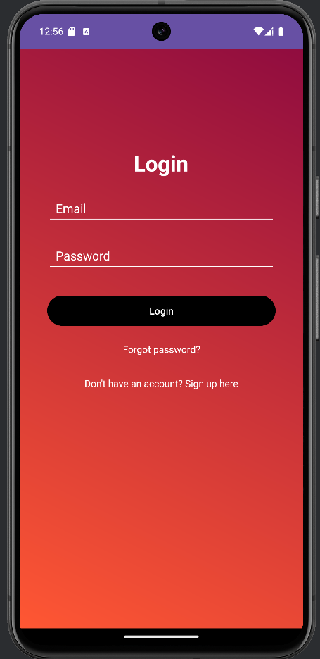
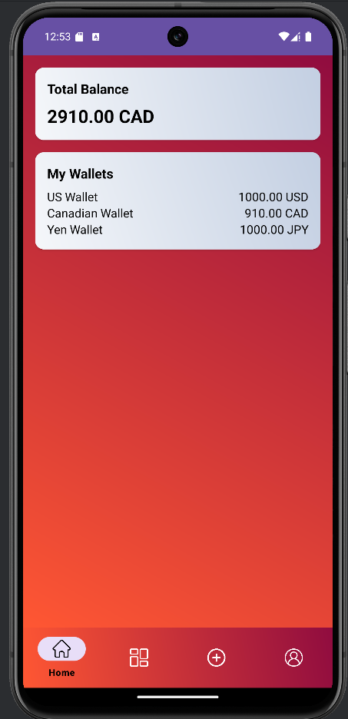
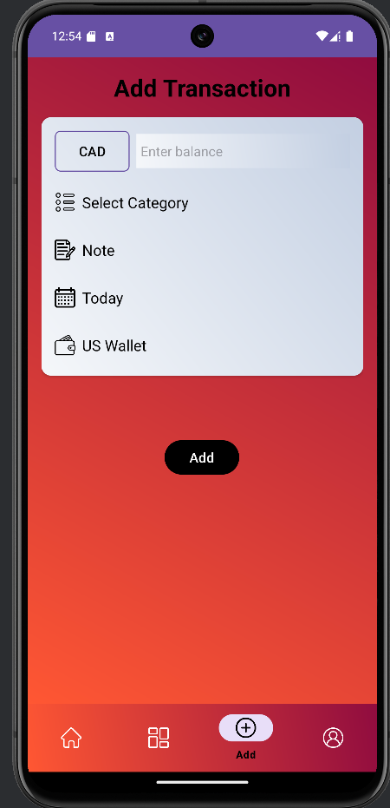
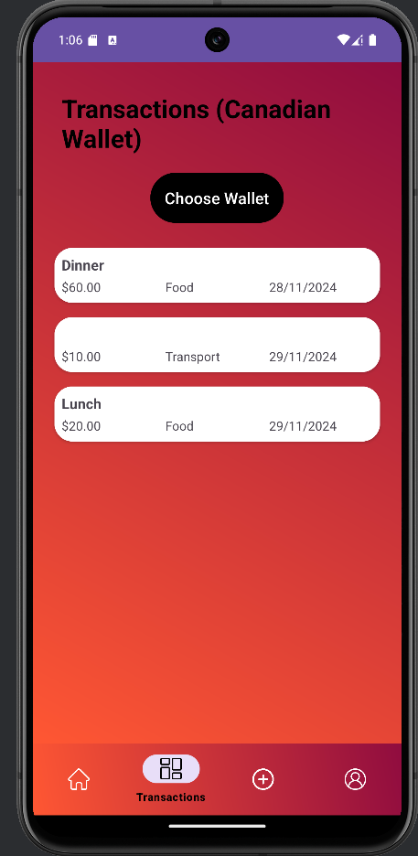
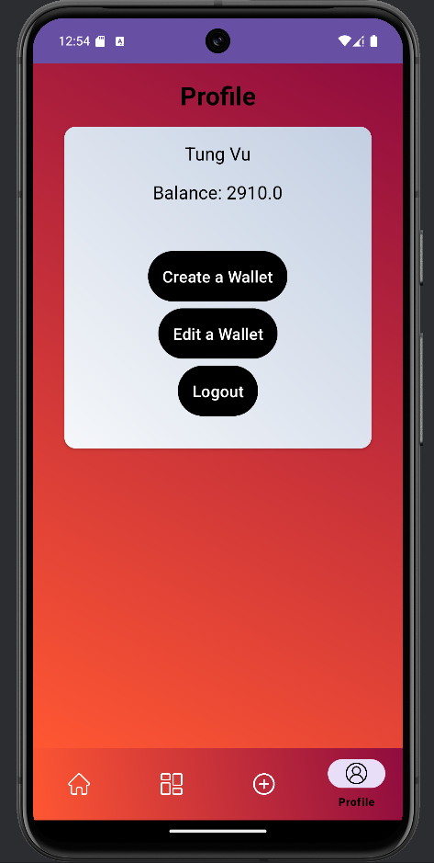
Final Design / Test Results

Slide 5
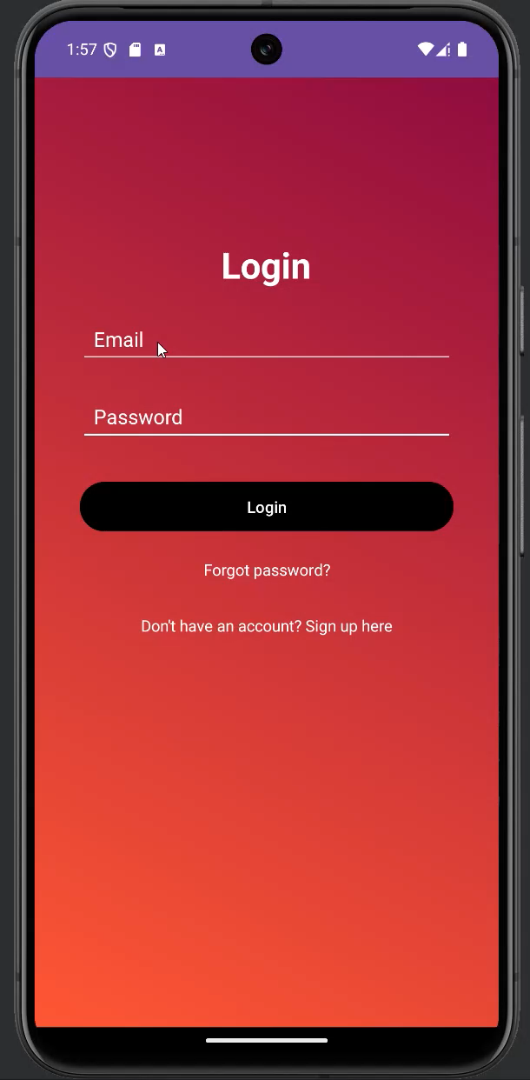

Slide 6
Summary
Successfully Integrated features:
Firebase Authentication (not included in Project Planning)
Fragments
Different views
Menu and Lists
On Going Development:
Graph Representation
Currency Exchange features to display total money for all Wallets

